Slide 1
Login :
Password :
BiotechTeam
**************
LOADING
…
Bertrand Faurie – 2020
Bioscience.fun

Slide 2
Login :
Password :
BiotechTeam
Local time – 05 : 11 PM
**************
Weather forecast
DISABLED
Station news
DISABLED
LOADING
…
Cafeteria menus
DISABLED
Messages
SECURITY
Bertrand Faurie – 2020
Bioscience.fun

Slide 3
Local time – 11 : 23 AM
Message
Personal problem – Read
From G^{al} B.G.Faurie – 6 hours ago
New antibiotic test – Read
From G^{al} B.G.Faurie – Yesterday
Develop new antibiotics – Read
From G^{al} B.G.Faurie – Las month
Clean your lab !!!! – Read
From San Drine – Last month
Lost your phone number – Read
Your crush from the bal – Last month
Bacteria outbreak !!! Emergency – Read
From G^{al} B.G.Faurie – Last month
Bertrand Faurie – 2020
Bioscience.fun

Slide 4
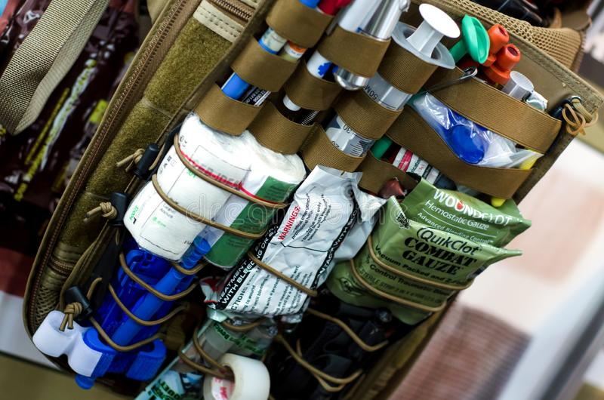
Local time – 11 : 23 AM
SECURITY TELEX
Transcription
Mars Endeavour 4, this is Raptor 5, do you read ?
We are under attack !
Please respond !
We get you, Raptor 5, go on !
Rebels, rebels everywhere ! The battery processor is dead ! Shot !
The Raptor vehicle is stuck, can’t move anymore. Can’t control battery acidity. Asking for instructions !
Your battery processor is dead, ok !
The lab is on it. Will find a solution to override the processor !
Have you any lab material, anything to help ?
We just have a first aid kit, with basics inside. We’re not a lab, we’re a transporter !
Send a picture of your kit
Raptor 5 is sending you an image
Image received
Bertrand Faurie – 2020
Bioscience.fun

